Slide 1
Types of Network and Transmission media
Lecture Number 3

Slide 2
Types
The types of network are classified based upon the size, the area it covers and its physical architecture.
The three primary network categories are LAN, WAN and MAN. Each network differs in their characteristics such as distance, transmission speed, cables and cost.

Slide 3
LAN
Group of interconnected computers within a small area. (room, building, campus)
Two or more pc's can from a LAN to share files, folders, printers, applications and other devices.
Coaxial or CAT 5 cables are normally used for connections.
Due to short distances, errors and noise are minimum. Data transfer rate is 10 to 100 mbps.
Example: A computer lab in a school.

Slide 4
MAN (Metropolitan Area Network)
Design to extend over a large area.
Connecting number of LAN's to form larger network, so that resources can be shared. Networks can be up to 5 to 50 km.
Owned by organization or individual. Data transfer rate is low compare to LAN.
Example: Organization with different branches located in the city

Slide 5
WAN (Wide Area Network)
Are country and worldwide network.
Contains multiple LAN's and MAN's.
Distinguished in terms of geographical range.
Uses satellites and microwave relays.
Data transfer rate depends upon the ISP provider and varies over the location. Best example is the internet.

Slide 6
Other Types
WLAN (Wireless LAN) : A LAN that uses high frequency radio waves for communication. Provides short range connectivity with high speed data transmission.
PAN (Personal Area Network) Network organized by the individual user for its personal use.
SAN (Storage Area Network) Connects servers to data storage devices via fiber-optic cables. E.g.: Used for daily backup of organization or a mirror copy.

Slide 7
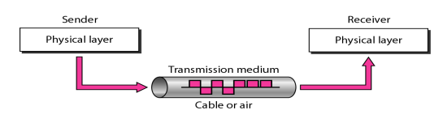
Transmission medium
A transmission medium can be broadly defined as anything that can carry information from a source to a destination.

Slide 8
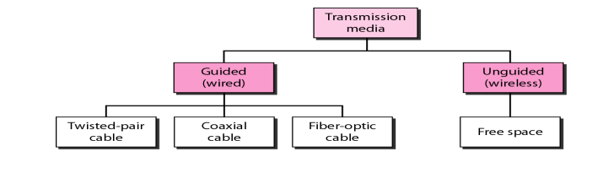
Classes of transmission media

Slide 9
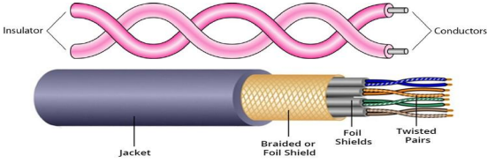
Guided Media
Guided Media: Guided media, which are those that provide a medium from one device to another, include twisted-pair cable, coaxial cable, and fiber-optic cable.
Twisted-Pair Cable: A twisted pair consists of two conductors (normally copper), each with its own plastic insulation, twisted together. One of the wires is used to carry signals to the receiver, and the other is used only as a ground reference.

Slide 10
Guided Media
Unshielded Versus Shielded Twisted-Pair Cable
The most common twisted-pair cable used in communications is referred to as unshielded twisted-pair (UTP).
STP cable has a metal foil or braided mesh covering that encases each pair of insulated conductors. Although metal casing improves the quality of cable by preventing the penetration of noise or crosstalk, it is bulkier and more expensive
The most common UTP connector is RJ45 (RJ stands for registered jack)
Applications:
Twisted-pair cables are used in telephone lines to provide voice and data channels. Local-area networks, such as l0Base-T and l00Base-T, also use twisted-pair cables.

Slide 11
Guided Media
Coaxial Cable
Coaxial cable (or coax) carries signals of higher frequency ranges than those in twisted pair cable.
coax has a central core conductor of solid or stranded wire (usuallycopper) enclosed in an insulating sheath, which is, in turn, encased in an outer conductor of metal foil, braid, or a combination of the two.
The outer metallic wrapping serves both as a shield against noise and as the second conductor, which completes the circuit.
This outer conductor is also enclosed in an insulating sheath, and the whole cable is protected by a plastic cover. The most common type of connector used today is the Bayone-Neill-Concelman (BNe), connector.

Slide 12
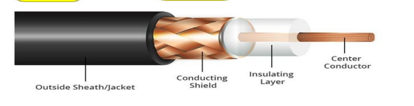
Coax Cable

Slide 13
Coax Cable uses
Applications
Coaxial cable was widely used in analog telephone networks,digital telephone networks Cable TV networks also use coaxial cables.
Another common application of coaxial cable is in traditional Ethernet LANs

Slide 14
Fiber-Optic Cable
A fiber-optic cable is made of glass or plastic and transmits signals in the form of light. Light travels in a straight line as long as it is moving through a single uniform substance
If a ray of light traveling through one substance suddenly enters another substance(of a different density), the ray changes direction. Bending of light ray.
Optical fibers use reflection to guide light through a channel. A glass or plastic core is surrounded by a cladding of less dense glass or plastic.

Slide 15
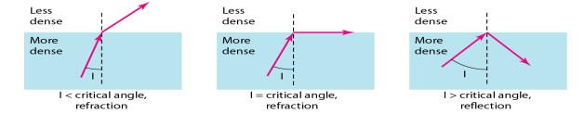

Fiber Optics

Slide 16
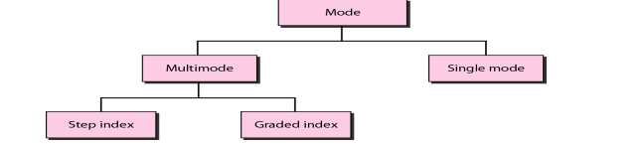
Propagation Mode for Fiber Optics

Slide 17
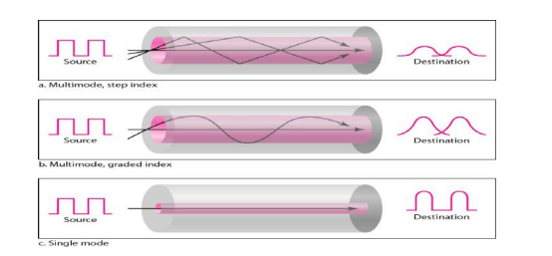
Modes of Propagation of Fiber optics
Multimode is so named because multiple beams from a light source move through the core in different paths. How these beams move within the cable depends on the structure of the core, as shown in Figure.

Slide 18
Modes of Propagation of Fiber optics
In multimode step-index fiber, the density of the core remains constant from the center to the edges. A beam of light moves through this constant density in a straight line until it reaches the interface of the core and the cladding.The term step index refers to the suddenness of this change, which contributes to the distortion of the signal as it passes through the fiber.
A second type of fiber, called multimode graded-index fiber, decreases this distortion of the signal through the cable. The word index here refers to the index of refraction.

Slide 19
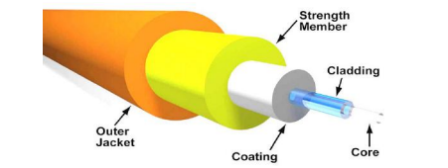
Modes of Propagation of Fiber optics
Single-Mode: Single-mode uses step-index fiber and a highly focused source of light that limits beams to a small range of angles, all close to the horizontal.

Slide 20
Elements of a Fiber optics
The subscriber channel (SC)
Connector
The straight-tip (ST) connector
MT-RJ(mechanical transfer registered jack) is a connector

Slide 21
Applications of Fiber Optics
Fiber-optic cable is often found in backbone networks because its wide bandwidth is cost-effective.
Some cable TV companies use a combination of optical fiber and coaxial cable, thus creating a hybrid network.
Local-area networks such as 100Base-FX network (Fast Ethernet) and 1000Base-X also use fiber-optic cable

Slide 22
Advantages and Disadvantages of Optical Fiber
Advantages:
1 Higher bandwidth.
2 Less signal attenuation. Fiber-optic transmission distance is significantly greaterthan that of other guided media. A signal can run for 50 km without requiring regeneration. We need repeaters every 5 km for coaxial or twistedpair cable.
3 Immunity to electromagnetic interference. Electromagnetic noise cannot affect fiber-optic cables.

Slide 23
Advantages
4 Resistance to corrosive materials. Glass is more resistant to corrosive materials than copper.
5 Light weight. Fiber-optic cables are much lighter than copper cables.
6 Greater immunity to tapping. Fiber-optic cables are more immune to tapping than copper cables. Copper cables create antenna effects that can easily be tapped.

Slide 24
Disadvantages
1- Installation and maintenance
2- Unidirectional light propagation. Propagation of light is unidirectional. If we need bidirectional communication, two fibers are needed.
3 Cost. The cable and the interfaces are relatively more expensive than those of other guided media. If the demand for bandwidth is not high, often the use of optical fiber cannot be justified.

